Slide 1
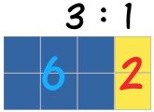
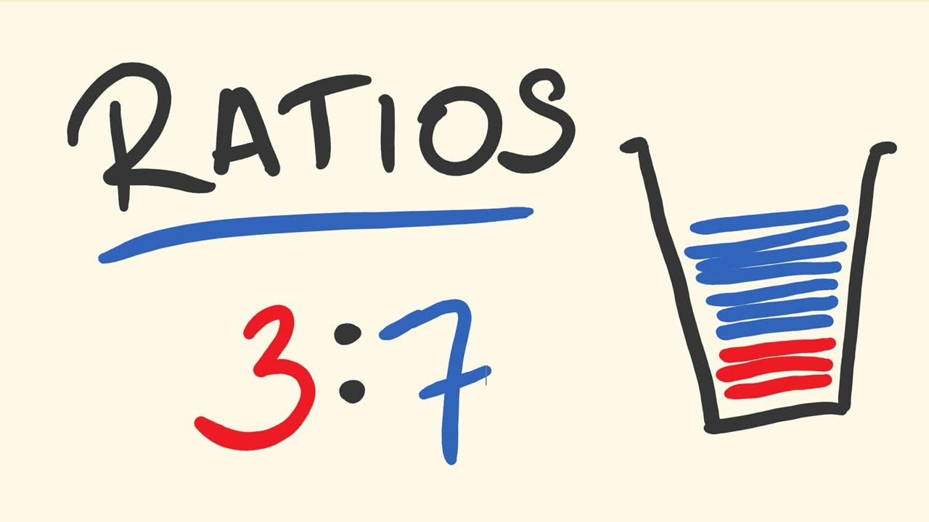
My Proportion Interactive Notebook
Name:
Class: 9-9
Term 2 Semester 1

Slide 2
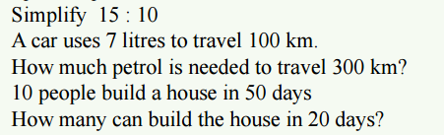
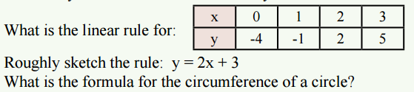
Warm Up
1
2
3
4
5
6
7
8

Slide 3
24
7
30
Date
Inverse Proportion
EQ – How is Inverse Proportion different from Direct Proportion?
What is inverse proportion?
Inverse proportion means an increase in one quantity
will cause a similar decrease in another quantity.

Slide 4
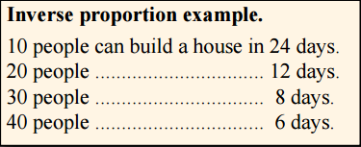
24
7
30
Date
Inverse Proportion
EQ – How is Inverse Proportion different from Direct Proportion?
What is inverse proportion?
Inverse proportion means an increase in one quantity
will cause a similar decrease in another quantity.

Slide 5
24
7
30
Date
Inverse Proportion
EQ – How is Inverse Proportion different from Direct Proportion?
What is inverse proportion?
Inverse proportion means an increase in one quantity
will cause a similar decrease in another quantity.
Increasing the number of people gives a decrease in the number of days taken, so it is Inverse proportion

Slide 6
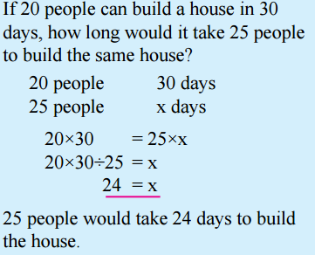
Work this example together

Slide 7
Work this example together

Slide 8
Work this example together

Slide 9
Work this example together

Slide 10
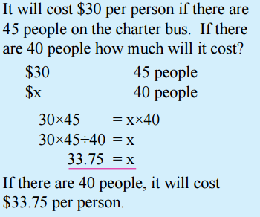
Work this example together

Slide 11
Work this example together
Now do Ex 6.8 p.80 Q1-7

Slide 12
Notes Review
24, 7 ,30
Date
Title
Essential question
Notes complete
Notes complete with colour and diagrams
Questions completed
Contents page filed in
Formula page filled in

Slide 13
Homework
Review your notes and write a summary answering the essential question.
Ex 6.8

